Slide 1

Promises at Ease
(Same old story)
By Vilva Athiban
@vilvaathibanpb

Slide 2


Slide 3
About Me
Javascript Developer
Occasional Blogger in Medium - Vilva Athiban P B
I do cartoons on Tech
Twitter @vilvaathibanpb , Youtube - Vilva Athiban
Open Source contributor.
I code on JS, React, GraphQL these days.
Also, I love to teach

Slide 4
Promises - Recap...
A Promise represents the eventual completion or failure of an asynchronous operation
It has three states - pending, fulfilled & rejected
.then(onFulfilled, onRejected) to chain promises
.catch() to handle errors / exceptions
.finally() to execute piece of code irrespective of completion or failure of the Promise

Slide 5

Demo & bit of Code

Slide 6
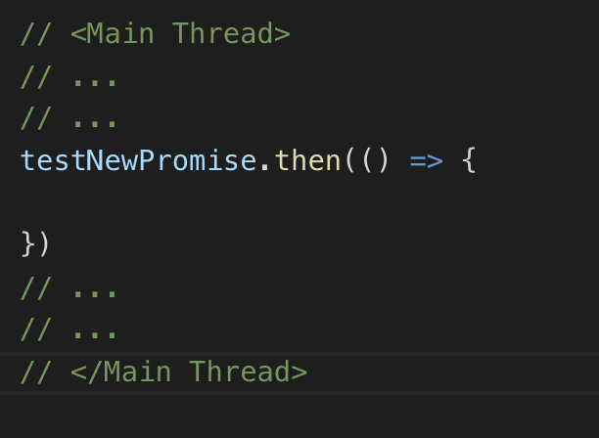
Promise

Slide 7
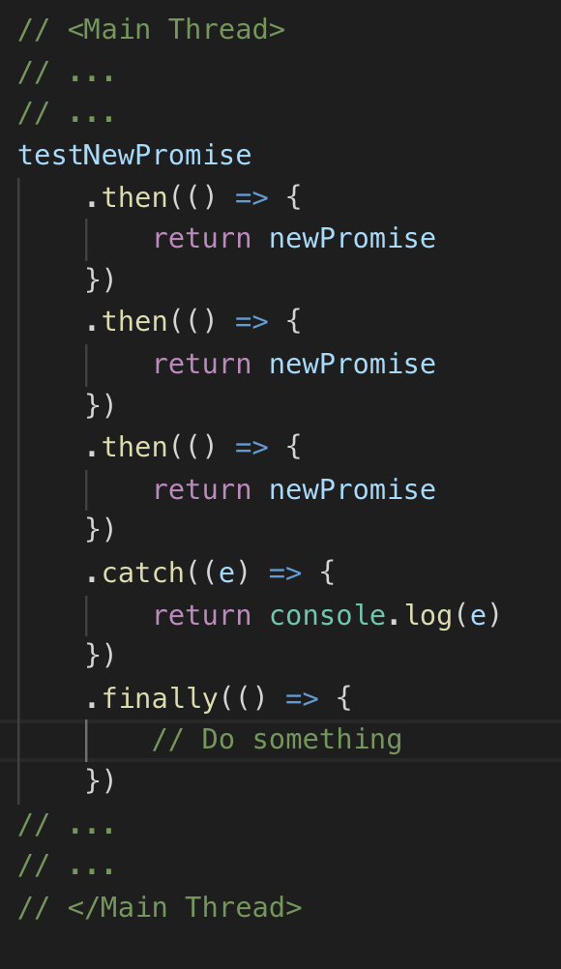
Promise - Chaining

Slide 8
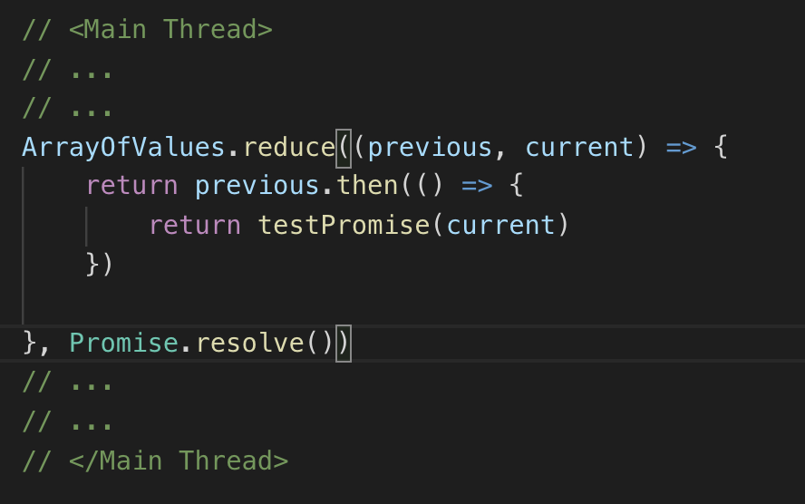
Promise - Dynamic Chaining

Slide 9
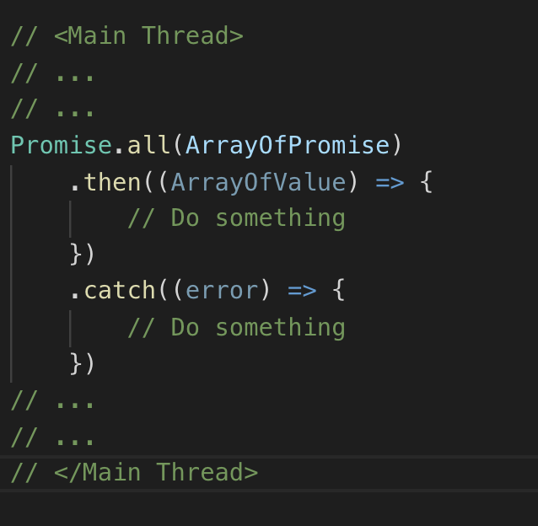
Multiple Promise - Promise.all

Slide 10
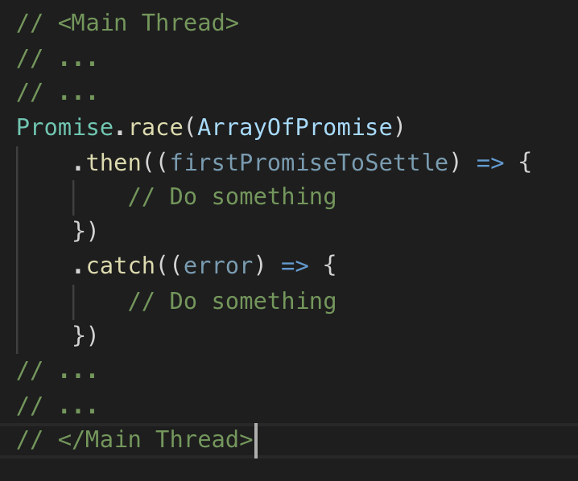
Multiple Promise - Promise.race

Slide 11
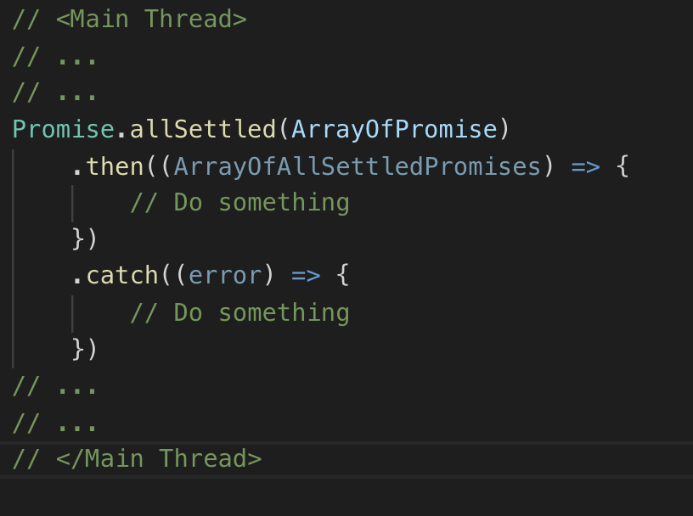
Multiple Promise - Promise.allSettled

Slide 12


Slide 13

QA Time
Thank you !
Feedback and Suggestions are welcome
Available for offline discussions
Follow me on twitter - @vilvaathibanpb

